Slide 1



AdventureWorks Sales Analysis.
By Mohit Dhaker

Slide 2
Overview
Database Source URL: https://learn.microsoft.com/en-us/sql/samples/adventureworks-install-configure?view=sql-server-ver16&tabs=ssms
Database Overview
AdventureWorks is a fictional company that manufactures and sells bicycles, parts, and accessories. The database contains multiple tables with detailed information about products, customers, sales, and employees.

Slide 3
Process Flow
Reference to Assignment
Schema & Database Initialization
Data Transformation
PowerBI Visualization
Migrating process to Azure
Initialize the AdventureWorks database.
Create the SpendMD schema to organize database objects within AdventureWorks.
Use the provided business rules and logic to transform the raw data within SSMS.
Write SQL queries to implement the transformations, such as filtering, aggregating, and joining data according to the specified business requirements.
Import the transformed data from AdventureWorks into Power BI.
Create relationships, measures, and calculated columns within PowerBI.
Develop interactive reports and dashboards.
Plan and execute the migration of the AdventureWorks database and associated processes to Azure.
Ensure compatibility and optimize the performance of the database and schema in the Azure environment.

Slide 4

Create Schema and Database
Begin by selecting 'New Query' in SQL Server Management Studio (SSMS).
Execute the query: CREATE DATABASE DevDB.
Once the database is created, create a schema within the same query.
Use the database with USE DevDB and create the schema SpendMD.

Slide 5
Transformation with SQL Server
Stored Procedure
1
Create stored procedure spAdventureBL
2
JOIN
Join FactInternetSales and FactInternetSalesReason on SalesOrderKey and insert into target table wrFinalData.
UNION
3
Union Of FactInternetSales and FactResellerSales
4
UPDATE
Create column [product Name] and update [product Name] in spendmd.wrFinalData using product ID
Update Remaining ProductName as “Uncategorized”,
Create views
5
Update Region from wrGeography using RegionID
vbSalesSummaryByRegion
Add column Categories and update using CategoryID
Update Territories from wrTerritories using TerritoriesID
vbSalesSummaryByProduct
vbSalesSummaryByCategor
6
Add column
Create column YearlyTotalByProduct
Create column AverageSaleByProductByYear and update with the average by product.
Create column CummulativeSumByProductByMonth
Create column CummulativeSumByProductByMonth

Slide 6




Data Ingestion into Power BI
Connect to Data Source
Open Power BI and select "Get Data."
Choose "SQL Server," enter server details, authenticate, and connect to your database.
Load Data into PowerBI
Select desired tables from your database to import.
Click "Load" to import data directly into Power BI for analysis.
Data Modeling
Navigate to the "Relationships" view.
Define relationships between different tables based on common fields to integrate data seamlessly for analysis.

Slide 7

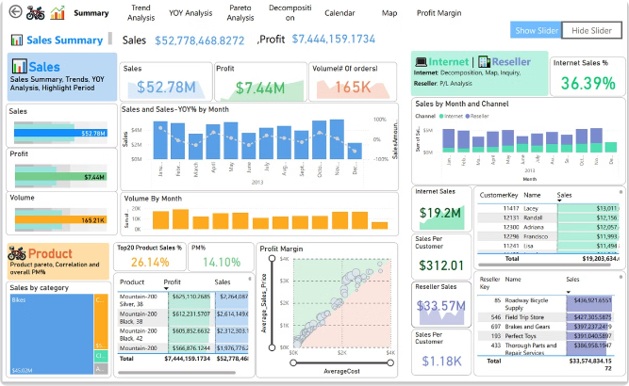
AdventureWorks Dashboard Overview
1
Sales Summary
2
YOY Analysis
Visualizes key metrics and trends in sales performance across different dimensions such as products, regions, or time periods..
Compares year-over-year performance to identify growth trends and anomalies, helping to understand business performance over time.
3
Trend Analysis
4
Pareto Analysis
Tracks and visualizes trends in various business metrics such as sales, revenue, or customer acquisition over specified periods, highlighting patterns and changes
Displays the significant factors contributing to overall results, helping prioritize efforts based on the 80/20 rule (where 80% of effects come from 20% of causes).
5
Decomposition
Breaks down complex metrics or KPIs into their contributing factors, revealing insights into what drives overall performance or outcomes.

Slide 8


Slide 9
Important DAX Queries
Total Sales
SUM('SpendMD wrFinalData'[SalesAmount])
TotalProfit
SUM('SpendMD wrFinalData'[SalesAmount]) - sum('SpendMD wrFinalData'[TotalProductCost])
Profit Margin %
DIVIDE( [TotalProfit], [Total Sales], 0 )
YOY varience %
DIVIDE([YOY varience], [LastYearSales], 0)
TotalInternetSales
CALCULATE(SUM('SpendMD wrFinalData'[SalesAmount]), 'SpendMD wrFinalData'[Channel] = "Internet")
LastYearSales
CALCULATE( SUM('SpendMD wrFinalData'[SalesAmount]),
SAMEPERIODLASTYEAR('SpendMD wrFinalData'[OrderDate].[Date]))

Slide 10

Azure for ETL

Slide 11
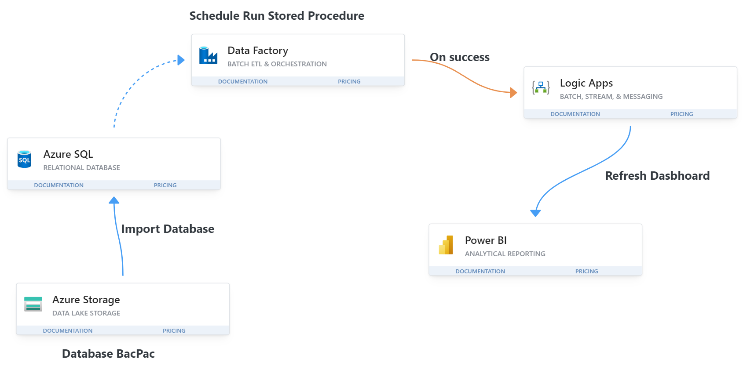

Slide 12
Thank You

